Slide 1
Python
Session – 2
Date – 12th May, 2022

Slide 2
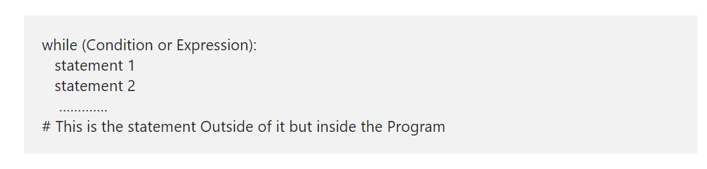
Python while Loop
The Python while Loop is used to repeat a block of statements for given number of times, until the given condition is False. A while loop in Python start with the condition, if the condition is True then statements inside it will be executed. If the given condition is false, it won’t execute at least once, which means, it may execute zero or more time and the syntax of it is:
The Python While Loop Syntax is as follows:

Slide 3
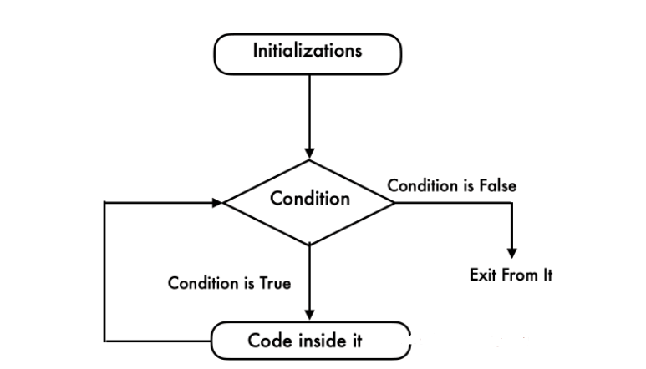
Python while Loop Flow Chart
This flow chart will explain you Visually and perfectly

Slide 4
Python while Loop Flow Chart Contd.
Python while loop will check for the condition at the beginning of it.
If the condition evaluates to True then it will execute the code inside it.
Next, we have to use Arithmetic Operator inside the Python while loop to increment and decrement the value.
After the value increments, it will again check the expression. As long as the condition is met, the statements in it will be executed.
If the expression becomes False then it will exit from it.

Slide 5
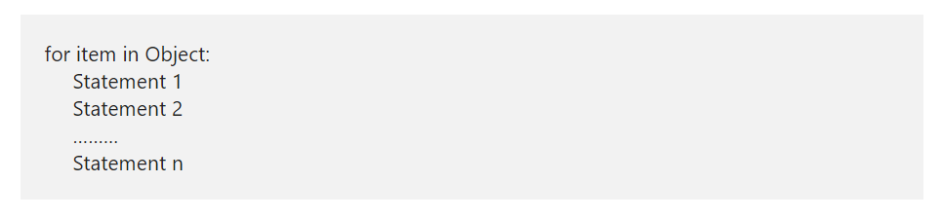
Python For Loop
The Python For Loop is used to repeat a block of statements until there are no items in the Object may be String, List, Tuple, or any other object. Let us see how to write the Python For Loop, range, and the else part with practical examples. Let us see the syntax of it, prior to getting into the details:
The syntax of the Python For Loop in is as follows:

Slide 6
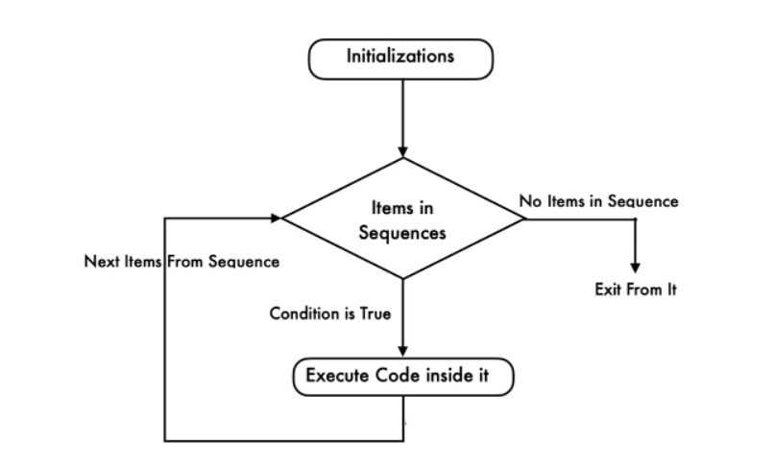
Python For Loop Flow Chart

Slide 7
Python For Loop Flow Chart Contd.
The execution process of the for loop in python is:
Initialization: We initialize the variable(s) here. Example i=1.
Items in Sequence / Object: Compiler will check the items in Objects. Example, individual letters in String word. If there are items in sequence ( True) then it will execute the statements within it or inside. If there is no item in sequence ( False) then it will exit.
After completing the current iteration, compiler will traverse to next item.
Again it will check the new items in sequence. As long as the items in sequence, the statements inside it will be executed.

Slide 8
Python break Statement
The Python break statement is very useful to exit from For, While and Nested Loops. While executing these code blocks, if the compiler finds this inside them, the compiler will stop executing the code inside it and exit immediately from the iteration.
For example, we have 5 lines of code inside the loop and we want to exit from it when certain condition is True otherwise, it has to execute them. In these situations we can place the Python Break statement inside the If condition.
If the condition is True then compiler will execute this statement. It means, the Python break Statement will exit the controller from the loop completely. Otherwise, it will execute all block of code.

Slide 9
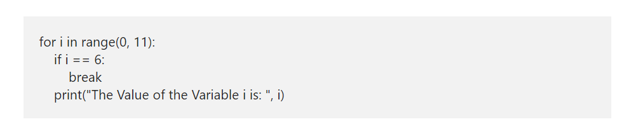
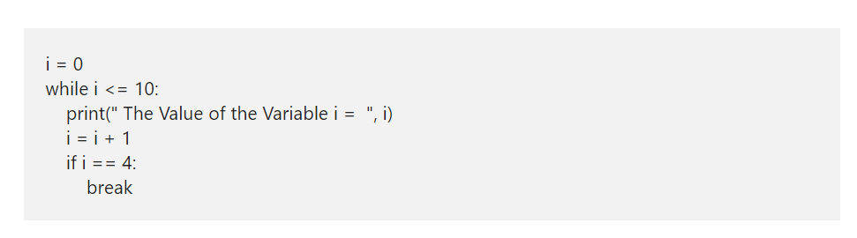
Python break Statement in For and While loop

Slide 10
Python continue
The Python continue statement is another one to control the flow of loops. Similar to Break statement, this Python continue statement is used inside For and While Loops. While executing these iterables, if compiler find this statement inside them, then compiler will stop the current iteration and starts the new iteration from the beginning.
For example, we have 10 statements inside the loop. And we want to skip executing the last 5 (statement6 — 10) when a certain condition is True or else it has to execute all the 10 statements inside a loop. In these situations, we place the condition after the 5th followed by the Python continue statement. If the condition is True then it will stop executing statement6 to 10 otherwise, it will execute lines 1 to 10.

Slide 11
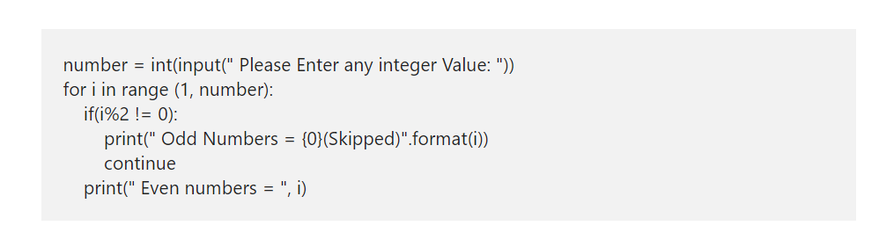
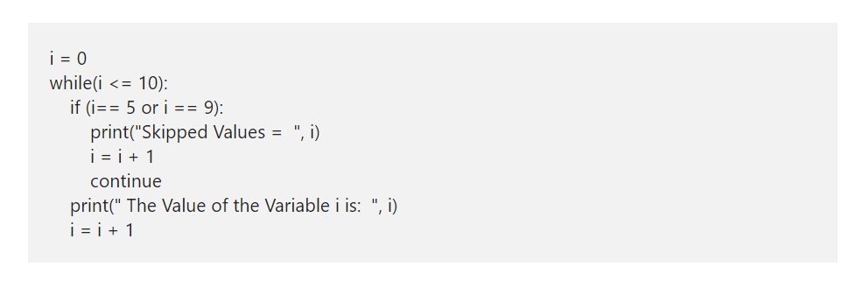
Python continue Syntax

Slide 12
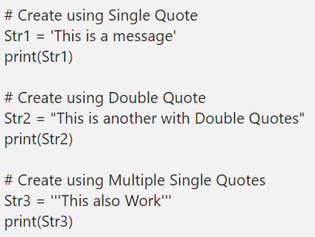
Python String
The Python String is nothing but a sequence of characters. In this section, we discuss how to create a String, accessing the individual characters (items), iterating the characters. Also, show you slicing String in Python programming language.

Slide 13
Access Python String items
We can access the elements in a Python String using indexes. Using an index, we can access each item separately. Index value starts at 0 and ends at n-1, where n is the length. For example, if the length is 5, the index starts at 0 and ends with 4. To access 1st value, use name[0] and to access the 5th value, then use name[4].
If you are using the Negative index numbers, it starts looking for items from right to left

Slide 14
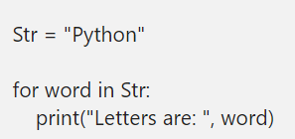
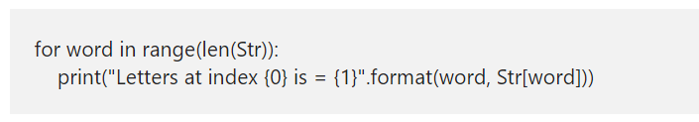
Iterate String
The Python For Loop is the most common way to traverse the characters or items in a string. This code helps us to iterate the str, and prints each character present in the str.
The above-specified code works nicely to print the characters inside it. However, to change the individual item, we need the Python index position also. To fix this, we have to use the range function along with for loop

Slide 15
string concatenation
Joining or combining more than one is called as the Python string concatenation or concat. There are multiple ways to concat.
We can use + operator to join more than one.
By placing more than one literal, joins them automatically.
Placing more than one inside the one and closed parentheses ()
* operator is repeating the sentence for a given number of times. Here it is three times.

Slide 16
Python String Slice
In python String Slice, the first integer value is the index position where the slicing start and the second is where the slicing end, but it does not include the content at this index position. For instance, if we define stritem[1:4], then string slicing starts at index position 1 and ends at index position 3 (not 4).
If you omit the first index, the slicing starts from the beginning.
If you omit the second argument, Slicing starts from the first position and continues to the last.
And, If you are using the Negative numbers as an index, the slicing starts from right to left.

Slide 17
Python String Functions
Functions Description
capitalize() It converts the first character to Capitalize and following characters to Lowercase.
casefold() It returns the given sentence in Lowercase.
center() This method is to Justify the line to Center and fill the remaining width with default white spaces
count() It Counts how many times the substring occurs.
encode() Prints the encoded version of a string object
endswith() This Python string functiuon displays TRUE if the string ends with the specified substring
expandtabs() It returns a copy of the given one, where all the tab characters replaced with one or more spaces.
find() The index position of the first occurrence. Otherwise, it displays -1 if the specified one not found
format() Useful for formatting
format_map() This Python function Format the string.
index() It returns the index position of the first occurrence of a specified substring. It raises ValueError if the specified one not found.
isalnum() TRUE if it contains letters and numbers
isalpha() TRUE if it has at least one letter, and all the characters are Alphabetic
isdecimal() TRUE if it has at least one letter, and all the characters are Decimal
isdigit() This python string function display TRUE if the string has at least one letter, and all the letters are Digits
isidentifier() TRUE if it is a valid identifier. Otherwise, it returns false.
islower() TRUE if it has at least one letter, and all the characters are in Lowercase
isnumeric() It displays TRUE if it has at least one letter, and all the letters are Numeric
isprintable() This python string function returns TRUE if all the letters are Printable
isspace() It prints TRUE if the sentence contains only white spaces
istitle() Prints TRUE if it has at least one character, and it is a Title.
isupper() TRUE if the sentence has at least one letter, and all the characters are in Uppercase

Slide 18
Python String Functions
Functions Description
join() Join (Concatenate) a list of substrings
ljust() Justify to the Left-hand side and fill the remaining width with default white spaces
lower() It converts the given String into Lowercase characters and returns a new.
lstrip() This python string functions removes the white spaces from the Left-hand side.
maketrans() It returns the transaction table. We can further use this transaction in translate() method.
partition() It partitions the given one at the first occurrence of the specified separator and returns a tuple with three arguments.
replace() This python string function searches for a specified word and replaces it with a new value.
rfind() It display the index position of the Last occurrence. It returns -1 if the specified one not found
rindex() It returns the index position of the Last occurrence. It raises ValueError if the specified Python string not found
rjust() Justify to the Right-hand side and fill the remaining width with default white spaces
rpartition() This python string functions partitions the given sentence using the specified separator and returns a tuple with three arguments.
rsplit() Split into a list of sentences based on the specified delimiter. It happens from right to left
rstrip() It removes the white spaces from the Right-hand side.
split() This python string functions is very useful to Split into a list of substrings based on the specified delimiter
splitlines() It prints a list of lines by breaking the given one at line boundaries.
startswith() TRUE if the sentence Starts with the specified substring
strip() It removes the white spaces from both ends. Performs both lstrip() and rstrip()
swapcase() Converts the Lowercase letters into Uppercase. And Uppercase letters into Lowercase
title() It converts the first character in each word to Uppercase and following characters to Lowercase
translate() Prints a Copy of the given one in which each character mapped with the transaction table.
upper() This Python string function converts into Uppercase letters and returns a new one.
zfill() Prints a copy filled with ASCII ‘0’ digits on the left-hand side of the sentence to make a length to the specified width.

